Slide 1
Class 22
Trade Adjustment Assistance by
Alan V. Deardorff
University of Michigan
2021
PubPol/Econ 541

Slide 2
TAA:
Trade Adjustment Assistance
The US program
Wage Insurance (ATAA)
Arguments against

Slide 3
TAA:
Trade Adjustment Assistance
The US program
Wage Insurance (ATAA)
Arguments against

Slide 4
US TAA
Started 1962
  Reason (Kennedy)
    “Obligation to render assistance to those who suffer as a result of national trade policy”
    Costs of trade are concentrated, compared to benefits
Latest expansion: 2002
  New features, but few take advantage of them

Slide 5
US TAA
Types of TAA
  Workers (since 1962)
  Firms (since 1962)
  Farmers and fishermen (since 2002)

Slide 6
US TAA
Eligibility: laid off due to
  Increase in imports (most)
  In upstream or downstream producers (secondary)
  Shift in production abroad (2nd most)

Slide 7
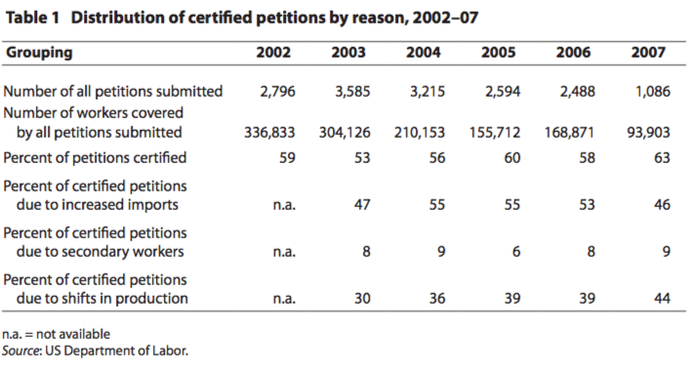
Source: Rosen (2008)
Notes:
Rosen, Howard F., “Strengthening Trade Adjustment Assistance,” Policy Brief No. PB08-2, Peterson Institute for International Economics, January 2008.

Slide 8
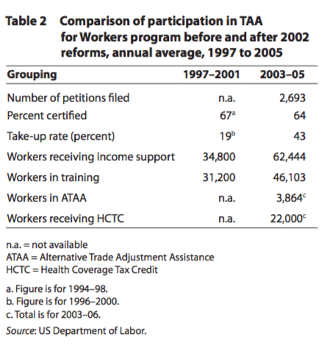
Source: Rosen (2008)
Notes:
Rosen, Howard F., “Strengthening Trade Adjustment Assistance,” Policy Brief No. PB08-2, Peterson Institute for International Economics, January 2008.

Slide 9
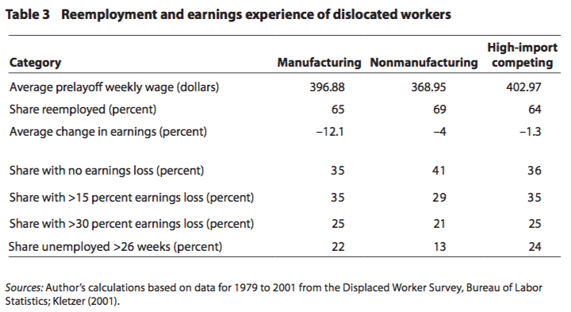
Source: Rosen (2008)
Notes:
Rosen, Howard F., “Strengthening Trade Adjustment Assistance,” Policy Brief No. PB08-2, Peterson Institute for International Economics, January 2008.

Slide 10
US TAA
Benefits:
  Income maintenance
    78 weeks vs. 26 weeks under UI
  All training expenses
  Health Coverage Tax Credit (HCTC)
  Job search costs (90%)
  Job relocation costs (90%)

Slide 11
US TAA
What’s wrong with TAA?
  Workers are not informed (esp. HCTC)
  Doesn’t cover service industries
  Certification done by firms, not industry
  Money for training apportioned poorly
    Some places run out, others leave $ unspent
  Self-employed don’t qualify
  No support for communities
  US spends less than others (but was first)

Slide 12
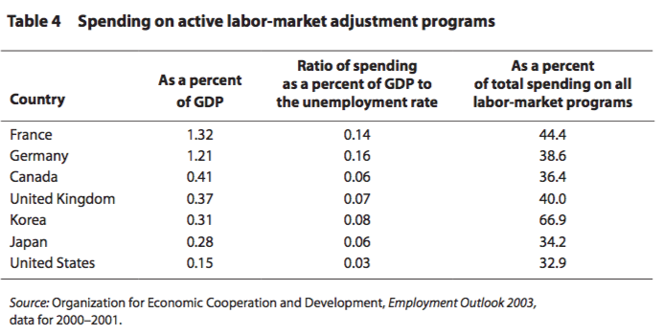
Source: Rosen (2008)
Notes:
Rosen, Howard F., “Strengthening Trade Adjustment Assistance,” Policy Brief No. PB08-2, Peterson Institute for International Economics, January 2008.

Slide 13
Pause for Discussion

Slide 14
  Questions on Rosen, “Strengthening TAA”
Who qualifies for TAA, and what do they get?
How does US expenditure on TAA differ from expenditure on similar programs in other major countries?
What’s wrong with US TAA?

Slide 15
  Questions on Lawrence,
  “A Numbers Argument…”
Are the gains from trade agreements large enough to justify the expenses of TAA?
Does Lawrence advocate for adjustment assistance only for trade-displaced workers?
Why does Lawrence associate TAA with passing Trade Promotion Authority?

Slide 16
TAA:
Trade Adjustment Assistance
The US program
Wage Insurance (ATAA)
Arguments against

Slide 17
Wage Insurance
What is it?
  Program that replaces a fraction (usually 50%) of any cut in wage when the unemployed take a new job. Workers get it for only a limited time
  Object is to encourage taking a new job even at a lower wage, with the hope that wage will then rise with experience
  Widely advocated by economists, not just for trade-displaced workers

Slide 18
Wage Insurance
ATAA: Alternative Trade Adjustment Assistance
  Part of 2002 expansion of TAA
  Available only to workers who are
    Over 50
    Earning less than $50,000 a year
    If they get new employment within 26 weeks
  Payment is
    50% of drop in wage for at most 2 years
    Not to exceed $10,000 per worker over the 2 years
Notes:
http://www.ctdol.state.ct.us/TradeAct/ataa%20presentation2a.pdf

Slide 19
Wage Insurance
Brainard and Litan argue
  Wage insurance is needed for all workers
  But especially for trade-displaced workers
    Their unemployment lasts much longer
    Their drop in wage is somewhat larger
    TAA does very little
  Advantage of wage insurance
    Speeds re-employment
    Subsidizes training (on the job)
    Encourages workers to consider alternative jobs
Notes:
http://www.ctdol.state.ct.us/TradeAct/ataa%20presentation2a.pdf

Slide 20
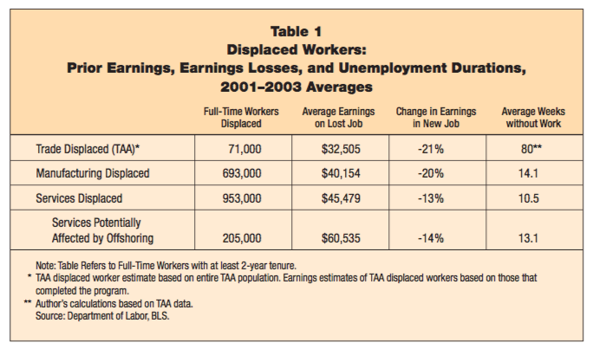
Source: Brainard et al. (2005)
Notes:
Brainard, Lael, Robert E. Litan, and Nicholas Warren, “Insuring America’s Workers in a New Era of Offshoring,” Policy Brief #143, The Brookings Institution, July 2005.

Slide 21
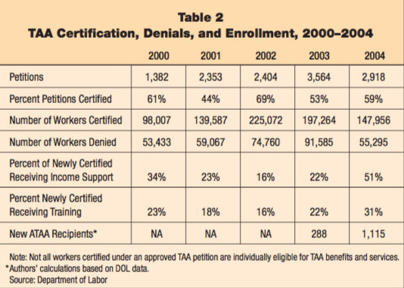
Source: Brainard et al. (2005)
Notes:
Brainard, Lael, Robert E. Litan, and Nicholas Warren, “Insuring America’s Workers in a New Era of Offshoring,” Policy Brief #143, The Brookings Institution, July 2005.

Slide 22
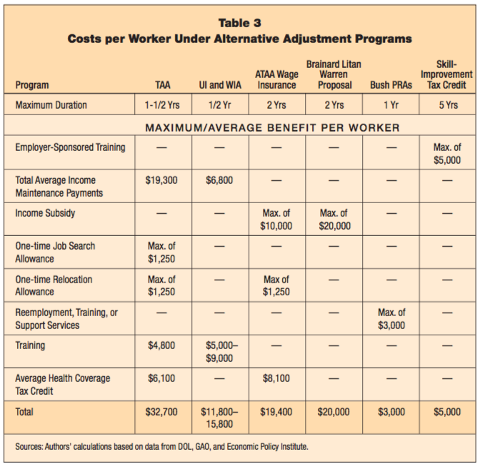
Source: Brainard et al. (2005)
Notes:
Brainard, Lael, Robert E. Litan, and Nicholas Warren, “Insuring America’s Workers in a New Era of Offshoring,” Policy Brief #143, The Brookings Institution, July 2005.

Slide 23
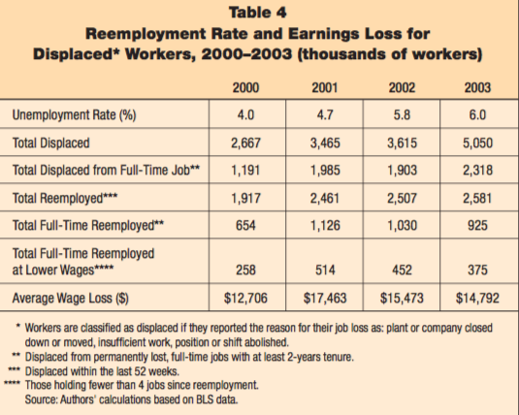
Source: Brainard et al. (2005)
Notes:
Brainard, Lael, Robert E. Litan, and Nicholas Warren, “Insuring America’s Workers in a New Era of Offshoring,” Policy Brief #143, The Brookings Institution, July 2005.

Slide 24
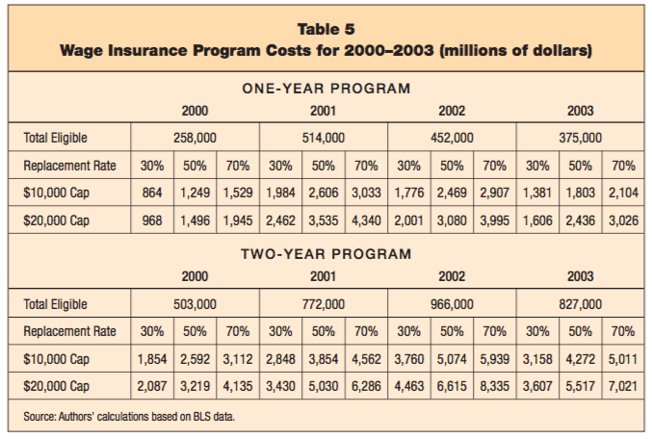
Source: Brainard et al. (2005)
Notes:
Brainard, Lael, Robert E. Litan, and Nicholas Warren, “Insuring America’s Workers in a New Era of Offshoring,” Policy Brief #143, The Brookings Institution, July 2005.

Slide 25
Pause for Discussion

Slide 26
  Questions Brainard & Litan.
  “Insuring America’s Workers”
Why is wage insurance more likely to encourage reemployment than unemployment compensation?
Why do the authors argue that it should be given to all displaced workers, not just those displaced by trade?
Why does wage insurance lead to more effective retraining than TAA?

Slide 27
TAA:
Trade Adjustment Assistance
The US program
Wage Insurance (ATAA)
Arguments against

Slide 28
Arguments against TAA
Arguments against US TAA (see James)
    Note free-market orientation: “As long as property is acquired legally and not through fraud, inequality is not unfair”
  Argument in favor was to get support for trade. That’s hasn’t worked.
  Trade-impacted workers do not suffer more than other unemployed.
  Program is not very effective or well-run.

Slide 29
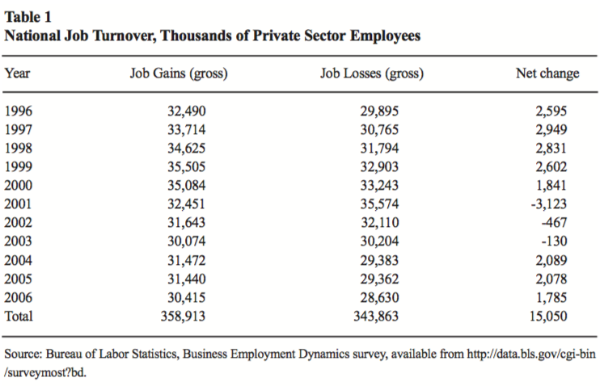
Source: James (2007)
Notes:
James, Sallie, “Maladjusted: The Misguided Policy of ‘Trade Adjustment Assistance’,” Briefing Paper No. 26, Center for Trade Policy Studies, Cato Institute, November 8, 2007.

Slide 30
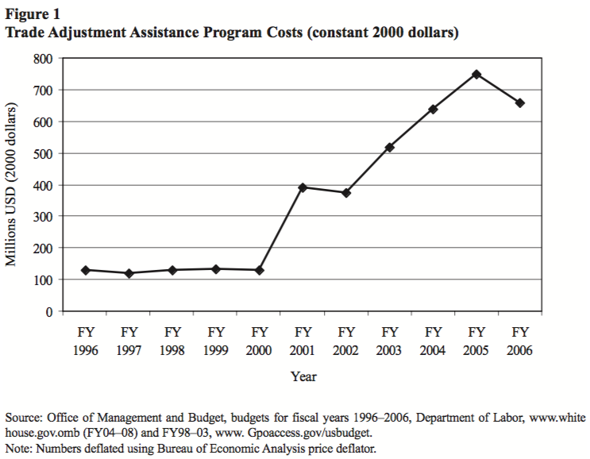
Source: James (2007)
Notes:
James, Sallie, “Maladjusted: The Misguided Policy of ‘Trade Adjustment Assistance’,” Briefing Paper No. 26, Center for Trade Policy Studies, Cato Institute, November 8, 2007.

Slide 31
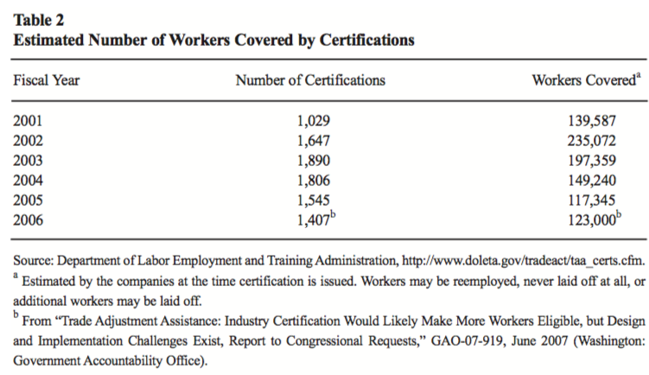
Source: James (2007)
Notes:
James, Sallie, “Maladjusted: The Misguided Policy of ‘Trade Adjustment Assistance’,” Briefing Paper No. 26, Center for Trade Policy Studies, Cato Institute, November 8, 2007.

Slide 32
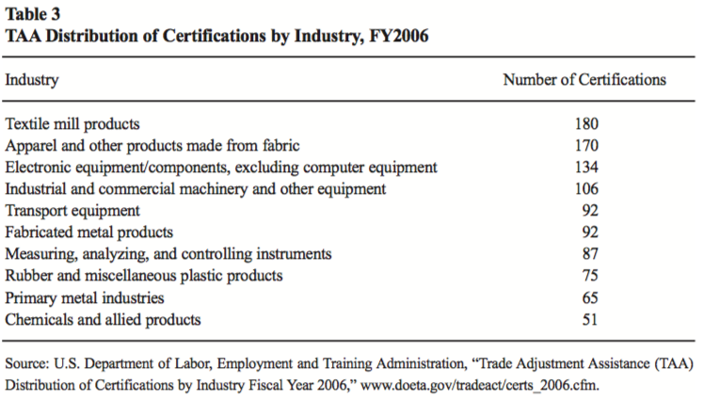
Source: James (2007)
Notes:
James, Sallie, “Maladjusted: The Misguided Policy of ‘Trade Adjustment Assistance’,” Briefing Paper No. 26, Center for Trade Policy Studies, Cato Institute, November 8, 2007.

Slide 33
Arguments against TAA
Arguments against EU TAA (see Beattie)
  EU TAA is European Globalisatin Fund since 2007
  Problems with it
    Complicated to administer
    Fails to provide much compensation
    Contributes to the perception that trade is harmful.
  Better would be “a Nordic-style comprehensive welfare and education system”

Slide 34
Pause for Discussion

Slide 35
  Questions on James, “Maladjusted”
What has been the primary motivation for enacting and extending TAA?
What sectors of the US economy have had the most certifications for TAA, according to the FY2006 data presented?
Are trade displaced workers more in need of help than workers displaced by other causes?

Slide 36
  Questions on Beattie,
  “Flaws of Trying…”
Does the author mention any examples of successful compensation of producers hurt by imports?
Does TAA achieve the aim of compensating losers from trade?
Does TAA achieve the aim of making trade agreements politically acceptable?
Why should advocates of globalization be opposed to TAA?

Slide 37
  Questions on Beattie,
  “Flaws of Trying…”
Does the EU have a program analogous to Trade Adjustment Assistance?
How much money does TAA hand out, and to how many workers?
Does the author favor doing nothing to help those who lose from trade? p

